Slide 1
Gaussian Noise & Super-Resolution
인공지능 팀 인턴 김수용

Slide 2
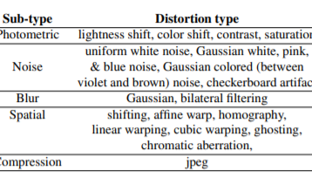


Traditional Distortions -> Gaussian Noise
1. 현재 완성 :
20개 중 18개
(이번주는 4개의 Noise)
2. 미완성 :
(1) Checkerboard Artifact
(2) Cubic Warp

Slide 3
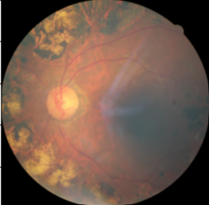
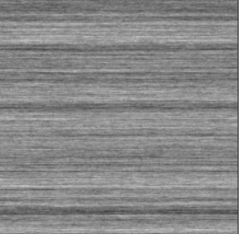
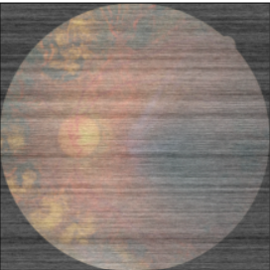
Gaussian Noise – Pink
Mean = 0
Std =30

Slide 4


Gaussian Noise – Blue
Mean = 0
Std =100

Slide 5

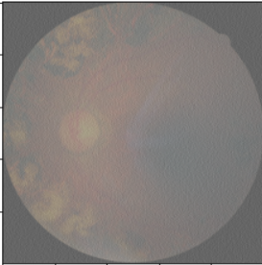
Gaussian Noise – Violet
Mean = 0
Std =100

Slide 6
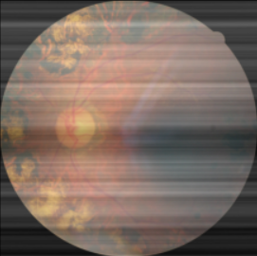

Gaussian Noise – Brown
Mean = 0
Std =30

Slide 7
Super-Resolution (CNN-Based Distortion)

Slide 8
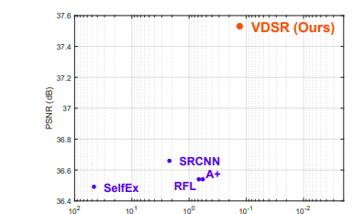
Accurate Image Super-Resolution Using Very Deep Convolutional Networks Jiwon Kim, Jung Kwon Lee and Kyoung Mu Lee Department of ECE, ASRI, Seoul National University, Korea
Intro
VDSR Model
High Learning Rate
Adjustable Gradient Clipping
Train convergence fast
Various scale factors (x2, x4, x10)
2. Residual Learning
r=y-x ( [y] is original, and [x] is down-sampled image and [r] is residual
Image )
(2) Loss function => 0.5 ||r − f(x)||^2 ( [f(x)] is reconstructed image )
=>Euclidean distance between the reconstructed image
( the sum of network input and output ) and original.
Run Time

Slide 9
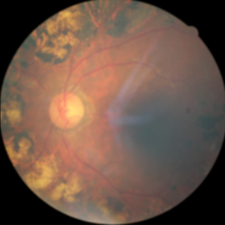
Default Setting
Model | VDSR
Upscale_Factor | 2
Image_Size | 500*500
Batch_Size | 64
Epochs | 200
Optimizer | SGD
Learning Rate | 0.1
Momentum | 0.9
Model_Weight_Decay | 1e-4
Scheduler_Step_Size | 50
Loss Function | MSE-Loss
원본
X 2
Down
Sampled

Slide 10
Epoch
Epoch | Test Loss (MSE) | Test PSNR (단위:dB)
30 | 0.0001 | 39.08
100 | 8.1443e-05 | 40.89
200 | 7.4665e-05 | 41.27

Slide 11
Batch Size
Batch Size | Test Loss (MSE) | Test PSNR (단위:dB)
32 | 7.7221e-05 | 41.12
64 | 7.4665e-05 | 41.27
96 | 8.2865e-05 | 40.82
128 | 8.3848e-05 | 40.77

Slide 12
Learning Rate
LR | Test Loss (MSE) | Test PSNR (단위:dB)
1 | 8.6493e-05 | 40.63
0.1 | 7.4665e-05 | 41.27
0.01 | 0.0001 | 39.64

Slide 13


Down-Sampled Images (Upscale Factor)
original
2
4
10

Slide 14
Upscale Factor
Upscale factor | Test Loss (MSE) | Test PSNR (단위:dB)
2 | 7.4665e-05 | 41.27
4 | 0.0001 | 39.5
10 | 0.0003 | 34.7

Slide 15
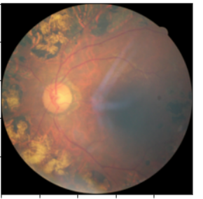
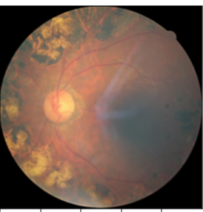
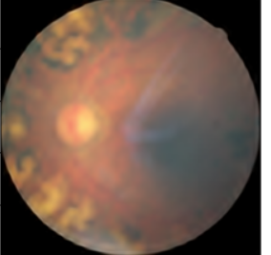
Reconstructed (Residual learning-Upscale Factor )
Reconstructed Images
(Upscale Factor)
original
2
4
10

Slide 16
Residual Learning
Loss function | Test Loss (MSE) | Test PSNR (단위:dB)
MSE-Loss (no residual) | 7.4665e-05 | 41.27
MSELoss(reduction="sum") (residual) | 1.6657e-05 | 47.78

Slide 17
Residual Learning-Learning Rate
LR | Test Loss (MSE) | Test PSNR (단위:dB)
1 | 1.7160e-05 | 47.65
0.1 | 1.6657e-05 | 47.78
0.01 | 1.7283e-05 | 47.62

Slide 18
Residual Learning-Upscale Factor
Upscale factor | Test Loss (MSE) | Test PSNR (단위:dB)
2 | 1.6657e-05 | 47.78
4 | 6.9672e-05 | 41.57
10 | 0.0004 | 33.82

Slide 19
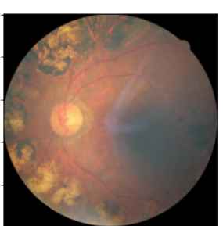
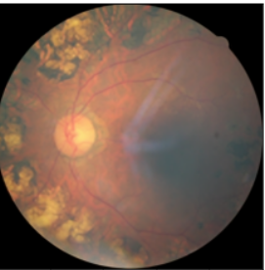
Reconstructed (Residual Learning-Upscale Factor )
original
2
4
10

Slide 20
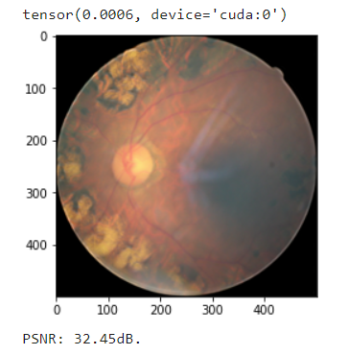
Up Scale factor x10 의 input image 에 대해서 train 한 이후에 x2 down sample 한 이미지에 대한 super resolution
여러 scale factor 에 대해서 train 하지 않은 이상 single scale factor 에 만 능숙한 모습을 보임
Non-residual 에서도 마찬가지

Slide 21
Next Plan
1. Super resolution =>
(1) Various Upscale Factor
(2) Change the Model
2. Auto Encoder => RF 데이터셋을 밑 논문 Method 에 맞추면서 구현
<Split-brain autoencoders: Unsupervised learning by cross-channel prediction>
R. Zhang, P. Isola, and A. A. Efros
3. Traditional distortions
(1) Checkerboard Artifact, Cubic Warp
(2) Change the parameter of the 20 distortions

Slide 22
Thank You

